Slide 1


INSTITUTE : UIE
DEPARTMENT : CSE
Bachelor of Engineering (Computer Science & Engineering)
WEB AND MOBILE SECURITY (Professional Elective-I)
(20CST/IT-333)
TOPIC OF PRESENTATION:
web content management/authoring, admin misconfigurations, and developer-driven mistakes
DISCOVER . LEARN . EMPOWER

Slide 2
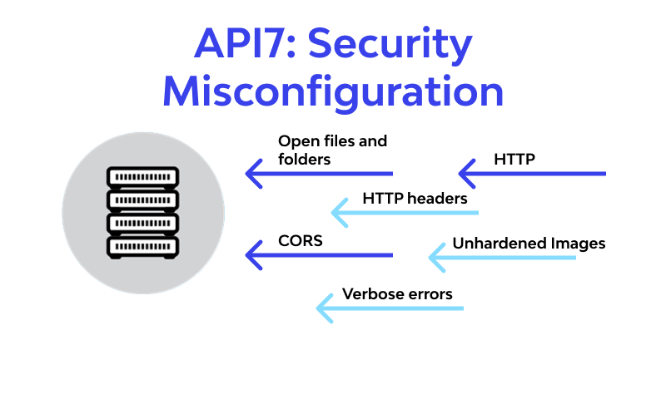
Lecture Objectives
In this lecture, we will discuss:
web content management/authoring, admin misconfigurations, and developer-driven mistakes

Slide 3
security misconfiguration
Security misconfiguration vulnerabilities take place when an application component is vulnerable to attack as a result of insecure configuration option or misconfiguration.
Misconfiguration vulnerabilities are configuration weaknesses that might exist in software subsystems or components. For instance, web server software might ship with default user accounts that a cybercriminal could utilize to access the system, or the software might have a known set of standard configuration files or directories, which a cybercriminal could exploit.
Furthermore, software might have vulnerable services enabled, such as remote administration operations. Misconfiguration vulnerabilities cause your application to be vulnerable to attacks that target any component of the application stack.

Slide 4
security misconfiguration
For instance, the following types of attacks could exploit misconfiguration vulnerabilities:
Code injection
Credential stuffing/brute force
Buffer overflow
Cross-site scripting (XSS)
Command injection
Forceful browsing
https://brightsec.com/blog/security-misconfiguration/

Slide 5
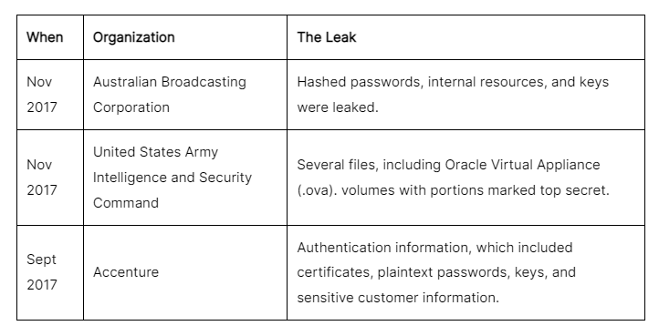
Real-Life Misconfiguration Attacks
1. NASA Exposed Via Default Authorization Misconfiguration
A security researcher discovered a security misconfiguration in the collaboration tool-JIRA. This single misconfiguration made many Fortune 500 companies (and NASA) vulnerable to a release of personal and corporate data.
2. Amazon S3 Misconfiguration Attacks

Slide 6
How to prevent security misconfigurations?
If vulnerabilities are the gateway to the network, it's the misconfigurations that attackers leverage to worm their way to the intended targets. Security misconfigurations are not hard to fix, but they are unavoidable in an enterprise operating at scale.
Finding them is a needle in the haystack, as they can be located across any component in an organization’s systems, such as its servers, operating systems, applications, and browsers. Lack of visibility and centralized means to remediate misconfigurations makes organizations fall victim to misconfiguration attacks.

Slide 7
Browser exploit
In cybersecurity, an exploit is a piece of code that utilizes vulnerabilities in computer software or hardware in order to perform malicious actions. These actions may include gaining control of a device, infiltrating a network, or launching some form of cyber attack. A browser exploit is a type of exploit that takes advantage of a web browser vulnerability in order to breach web browser security.

Slide 8
How can browser exploits be prevented
1. Install firewall software and other security software Firewall software acts as an extra barrier between the Internet and the web browser, which can block suspicious websites, and catch known threats before they breach web security
3. Be careful when browsing the web, especially when downloading files If a website looks suspicious, it probably is. Keep to well-known URLs and safe websites. It’s very important that users only download files from trusted sources, especially when it comes to downloading software applications or browser extensions, which could easily be infected with an exploit
2. Keep all software up to date Web browser software, and any applications that access the web, must be kept up to date. This is because when a vulnerability in software is found, the software vendor often releases a patch to fix the issue causing it, so that browser exploits relying on the vulnerability cannot cause any harm. Regularly updating software provides protection against more recent exploits.

Slide 9
References:
Books:
Web Design With HTML, CSS, JavaScript and jQuery Set, 1st Edition, by Jon Duckett.
Hacking Exposed Web Applications, 3rd edition, Joel Scambray, Vincent Liu, Caleb Sima, Released October 2010, Publisher(s): McGraw-Hill
Video Lectures :
https://www.youtube.com/watch?v=9ZokuRHo-eY
https://getvoip.com/blog/2020/05/06/voip-security/
Reference Links:
https://www.ericom.com/whatis/browser-exploit/
https://www.nibusinessinfo.co.uk/content/remote-access-security-issues

Slide 10

THANK YOU

